Slide 1
Cognitivity
Mid-semester presentation

Slide 2
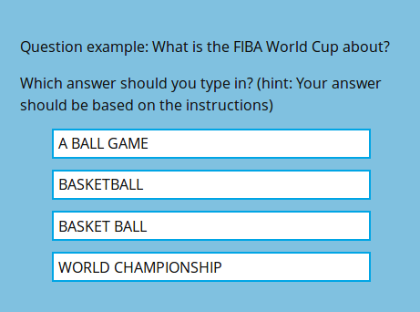
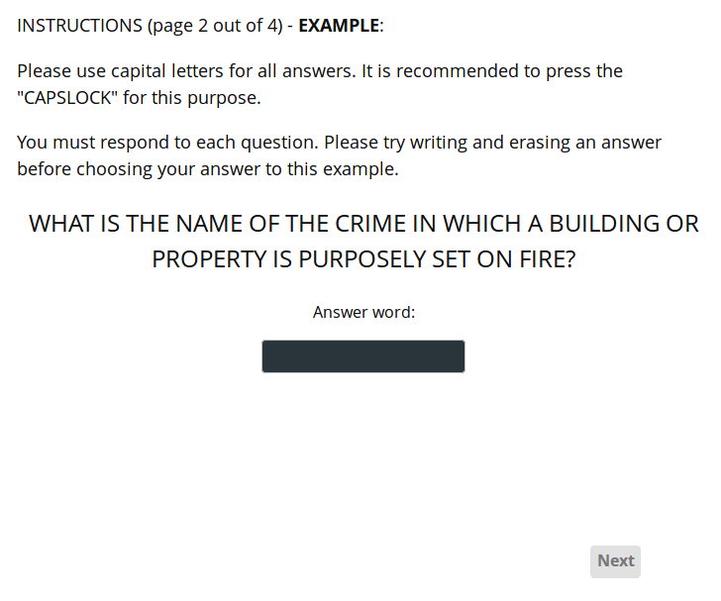
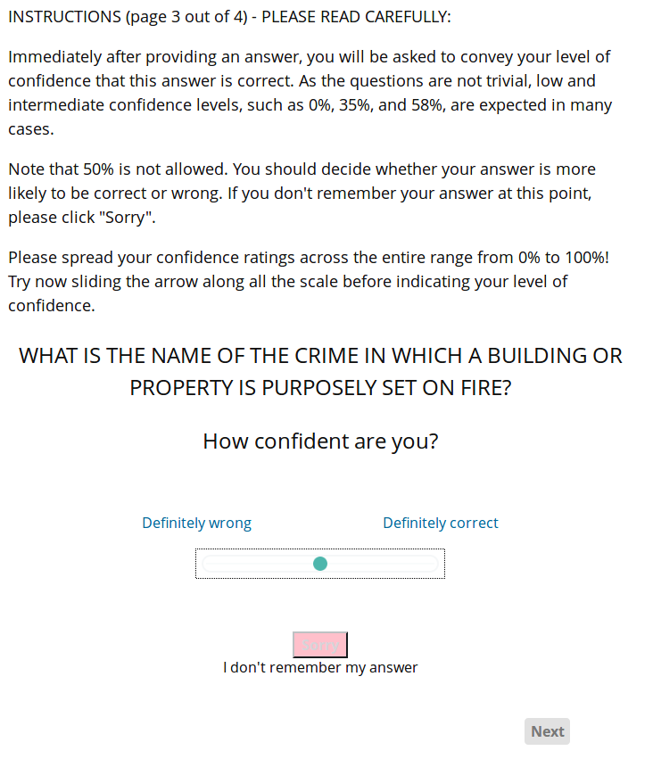
A Cognitive Test Example

Slide 3
Project goal: Create cognitive tests
Creating cognitive tests can be tough work, especially when these tests consider various aspects of a cognitive process.
The project mainly focuses on eliminating the tedious parts of the job by making a neat environment for it.
“Cognitivity” is a platform for creating and conducting cognitive tests for examinees all around the world.
Notes:
Aspects the test should take into consideration:
How certain a subject is about his answer?
Did a subject change his answer?
How long did it take for the subject to answer?
Was the subject focused on the question?
Did the distractions in the test affect the subject, and how?
Rakefet previously did her job very crudely. She used a broken system, lacking alot of features she found are very important for a cognitive test, and the results were not organized (saved in csv files, scattered in the tester’s personal computer).
Out objective is to provide a neat and comfortable platform for Rakefet (and her grad students, or anyone she deems appropriate) to manage the creation and the conducting of a full cognitive test.

Slide 4
The “Cognitivity” Project
Cognitivity is led by Tanya Brokhman.
The Project is implemented by a group of six students: Ophir Katz, Daniel Lyubin, Mark Erlich, Guy Shemesh, Pe’er Sagiv and Ben Hunter.
Our Client is Rekefet Ackerman - a professor in the Industrial Engineering faculty. The need for this project came from her past experience.
Notes:
Talk about how rekefet described her work on her projects. Mention that she was a programmer, so she knew how to create a test by writing code, but the system was very disorganized.

Slide 5
Supported features - Test manager
Login screen.
Question blocks - modularity in test creation.
Randomization of question positioning.
Accessing information about examinees, and ongoing tests.
Notes:
Login screen - self explanatory. Talk about access to sensitive data by users who are not administrators.
Question blocks - modularity in test creation - each block has a single type of question, can be randomly generated from the database, can be moved and reused between projects.
Random question positioning in a block - a block that contains questions can be reorganized by questions’ order.
Accessing information - the data collected by these tests will be analyzed by the test manager, so the results of every project should be exportable.

Slide 6
Supported features - Examinee
Time measurement (per question/test).
Several kinds of questions.
Distractions for the examinee.
Several positions for questions and answers.
Checking if an examinee exited the test before finishing it.
Notes:
Time measurement - one of the core features of the project - Rakefet thinks that measuring the time it takes for a subject to answer a question, or a cluster of questions, or the time that passes between answers switching (etc etc) is extremely important to understand the cognitive process in a subject’s mind while solving a test. We will provide alot of flexibility about time measuring.
Different types of questions - Rakefet’s tests have different type of question, each can have multiple (or none) distractions.
Positioning - Rakefet thinks its important to have different positioning for the answers in multi-choice type questions, for analyzing the difference between them.
Exiting a test - Rakefet believes it is important to not take into account subjects who are not totally focused in answering a question. Which is why all subjects who jump between windows or tabs during a test will be marked as such.

Slide 7
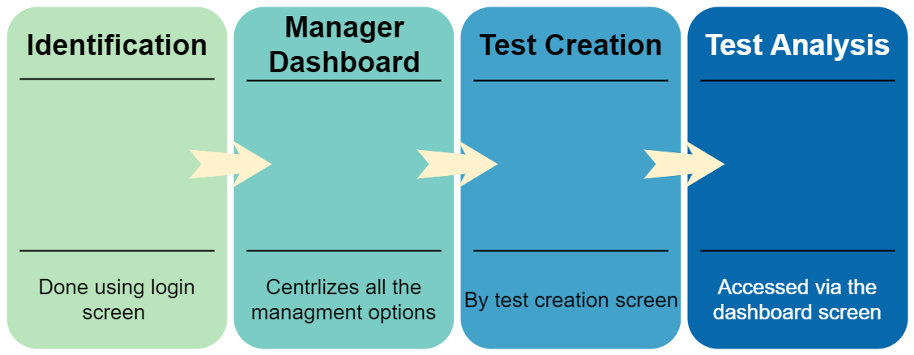
Manager Workflow
Notes:
Identification - to make sure the user is an admin - needed permission control for creating and assigning tests.
Manager Dashboard - Shows all tests, offers an interface for adding and editing tests (projects), and more management options such as distribution of tests, getting test results and more…
Test Creation - the interface via which the manager can create a test from scratch, or from a copied test version.
Test Analysis - the manager will be able to control how the results of a test will be outputted. We will provide full control by adding a sql query to be executed on the database. The output will later be used in Rakefet’s own way.

Slide 8
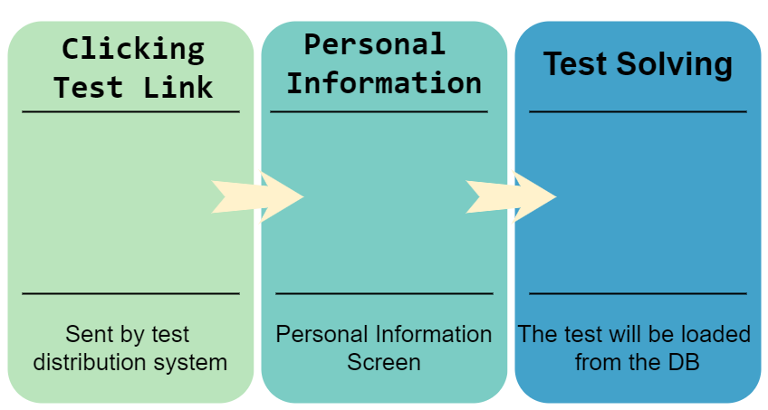
Examinee Workflow
Notes:
Clicking Test Link - a test will be distributed by a test manager via a web page link.
Personal Information - The subject of a test will fill in a personal info form for statistical analysis based on a project’s result.
Test Solving - the Test will be loaded from the database and the subject will begin answering it.

Slide 9
The manager’s flow
How will it look from the manager’s point of view?
Let’s see…

Slide 10
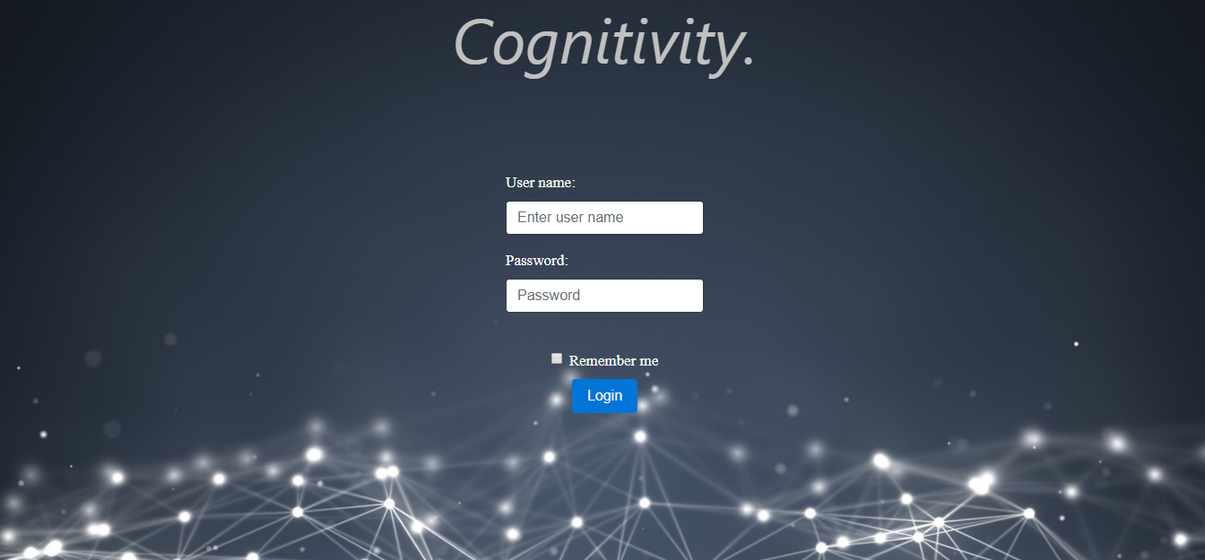
The login page

Slide 11
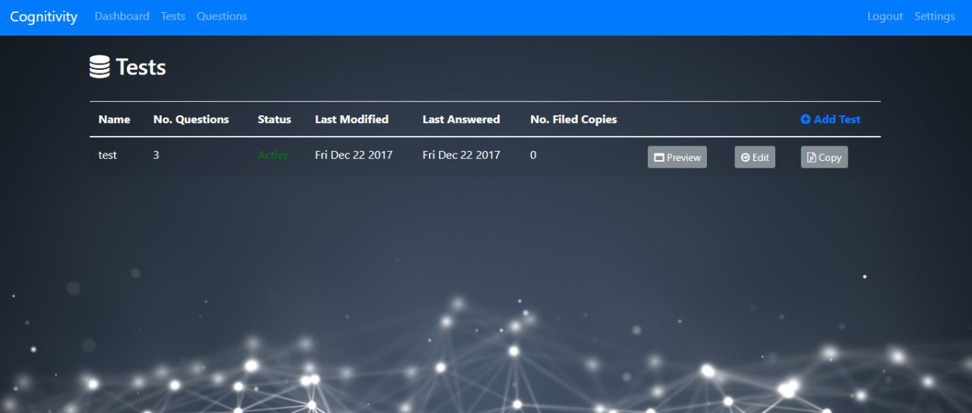
The main dashboard page

Slide 12
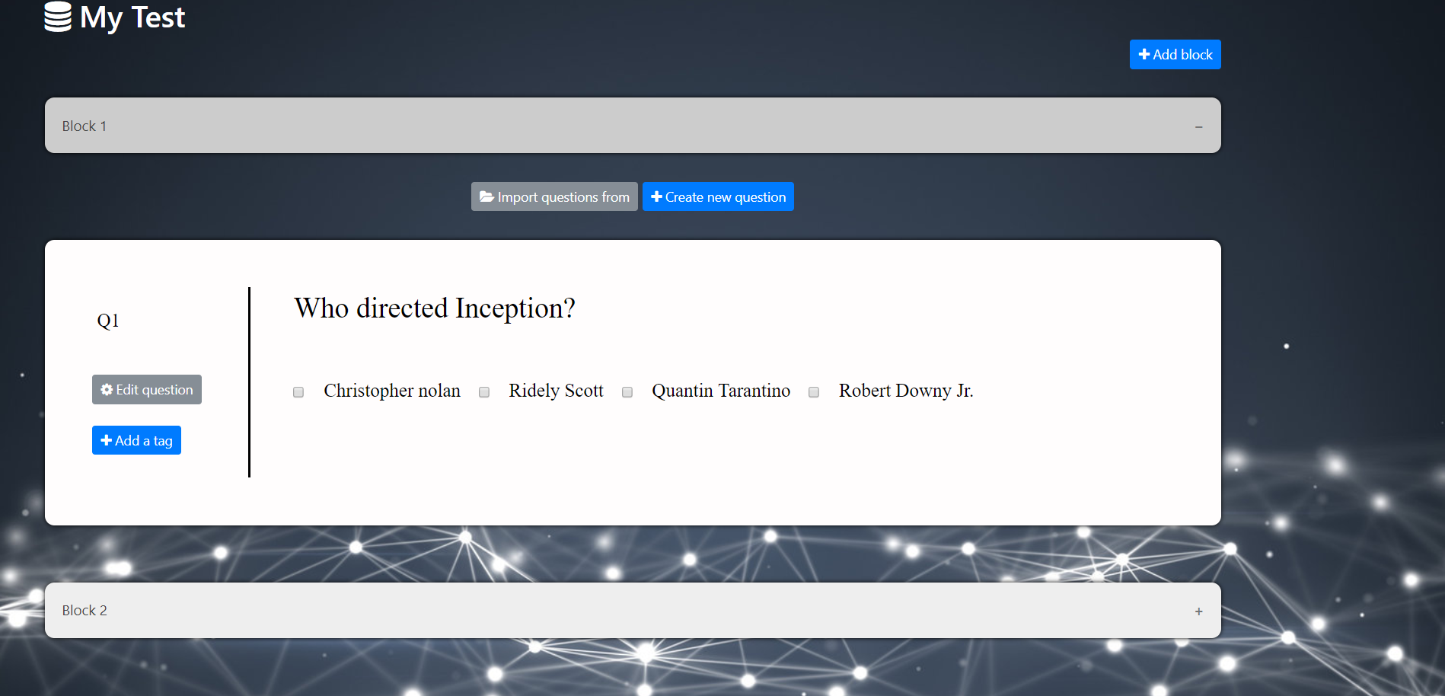
We start by creating a test !

Slide 13
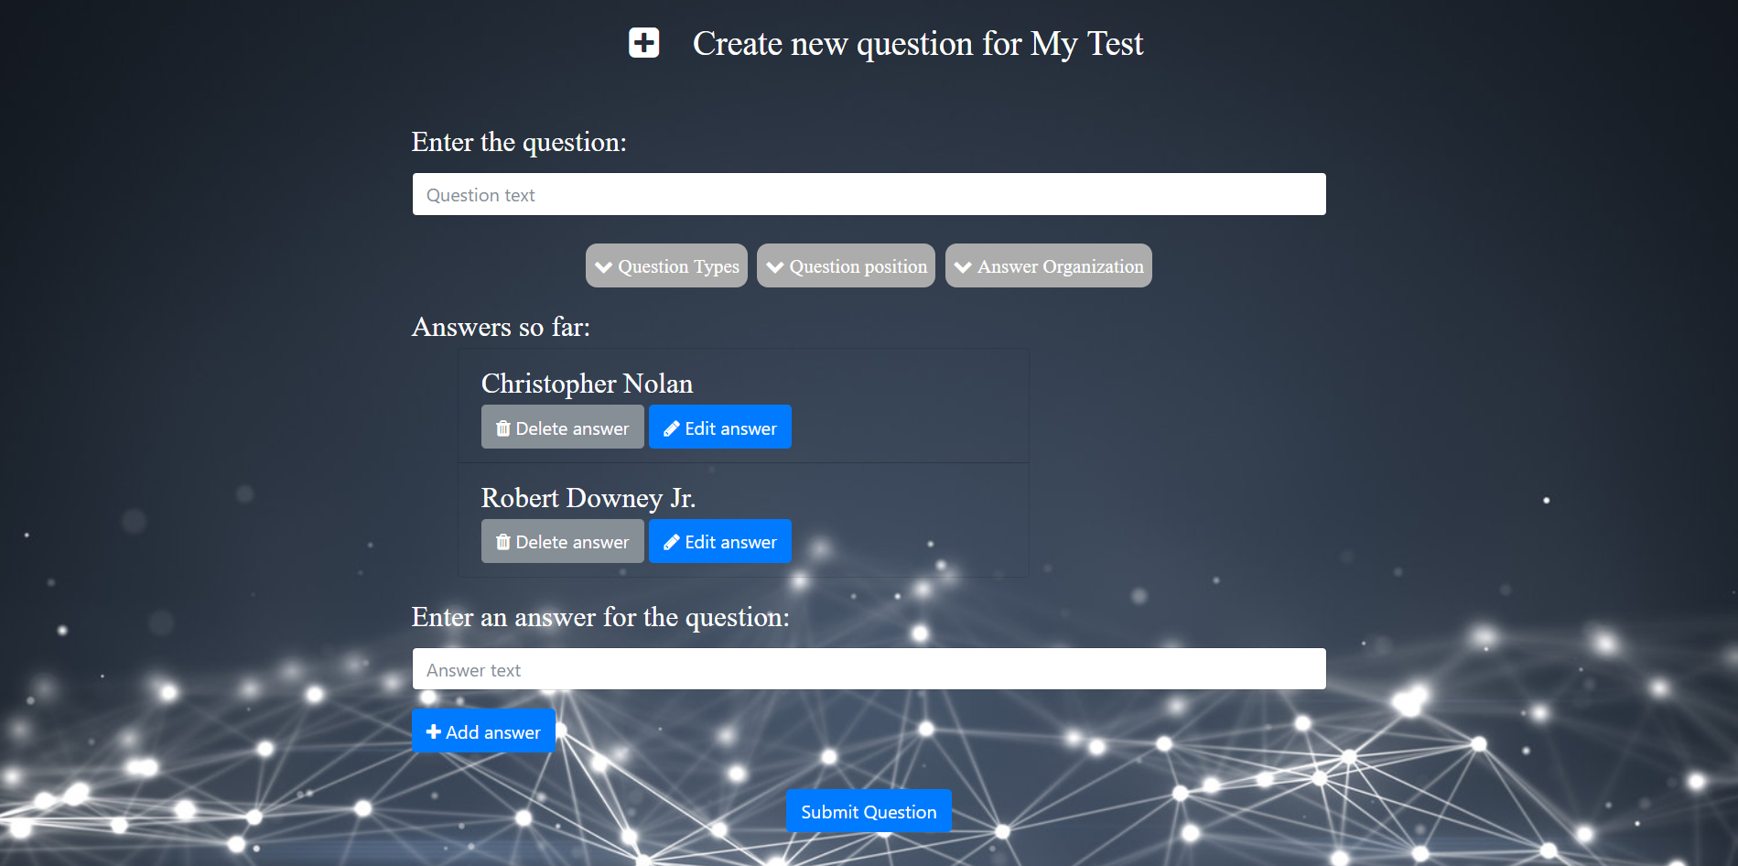
Adding a question

Slide 14
The examinee’s flow
And how will it look from the examinee’s point of view?

Slide 15
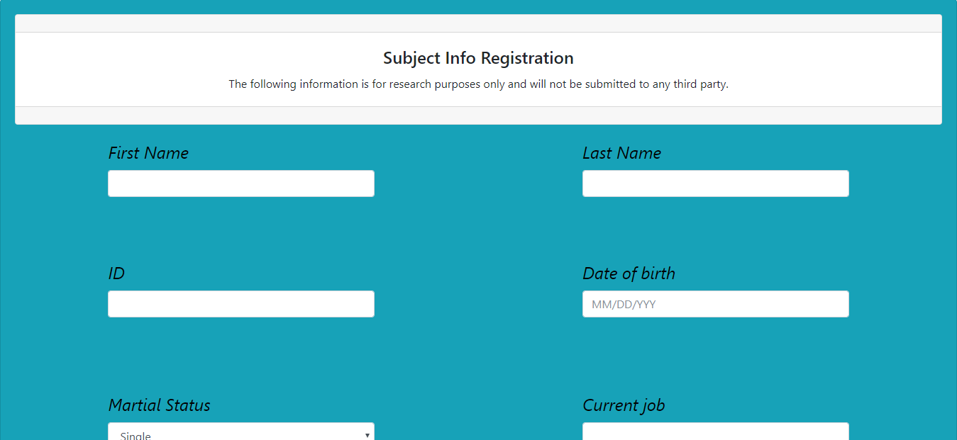
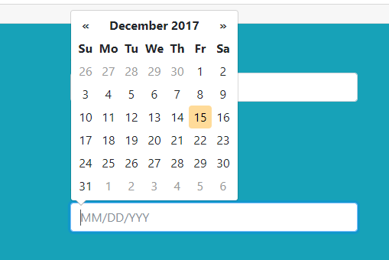
Registration

Slide 16
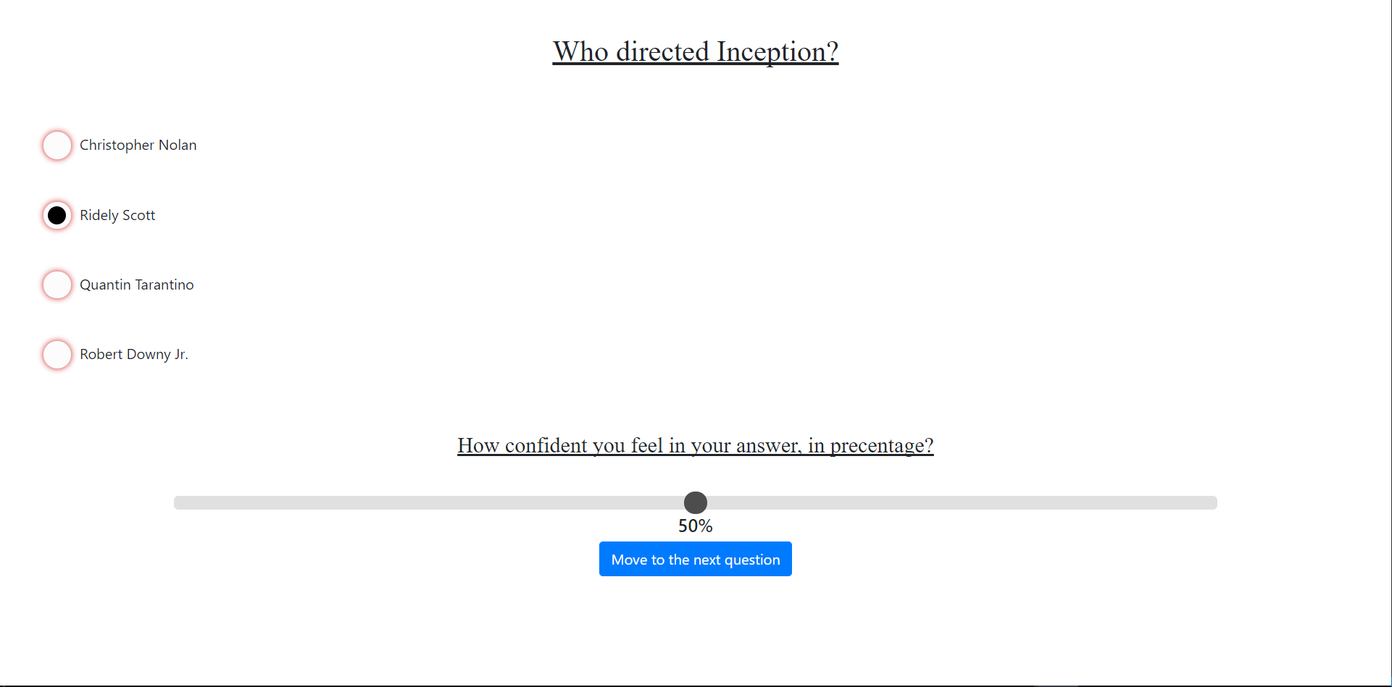
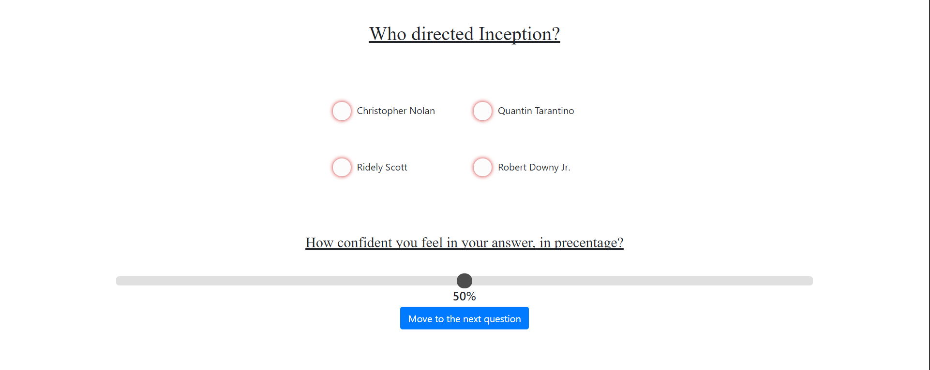
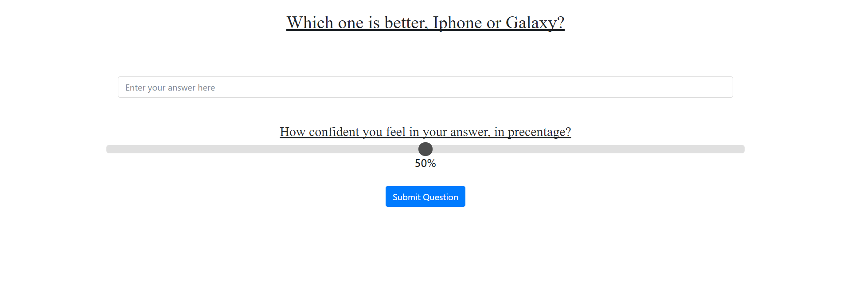
Different kinds of questions

Slide 17
Our Sprints

Slide 18
Sprint 1 - General
Gathered requirements from the client.
Defined HLD document for the whole year.

Slide 19
Sprint 1 - frontend
Different question designs (Different answers positions).
Different question types (multi-choice, open text, etc).
Project viewing window as a manager.
Personal info form for an examinee.

Slide 20
Sprint 1 - backend
Defining database tables.
Configuring a routing method for cliendside requests to DB.
Defining database access services.

Slide 21
Sprint 2 - frontend
Project creation:
○ Division into blocks which include the questions.
○ Providing modularity and different types of question
organization.
Project editing:
○ Adding/removing blocks.
○ Editing questions.
Copying a project.
Showing a project in “preview mode”.

Slide 22
Sprint 2 - backend
Finishing all of the required services.
Providing results for answered projects, question details.
Saving new questions, blocks, projects.
Allowing execution of managers’ custom queries.
Providing login mechanism.

Slide 23
Next Semester
Support all time measuring related features.
Test analysis tools for a test manager.

